Slide 1
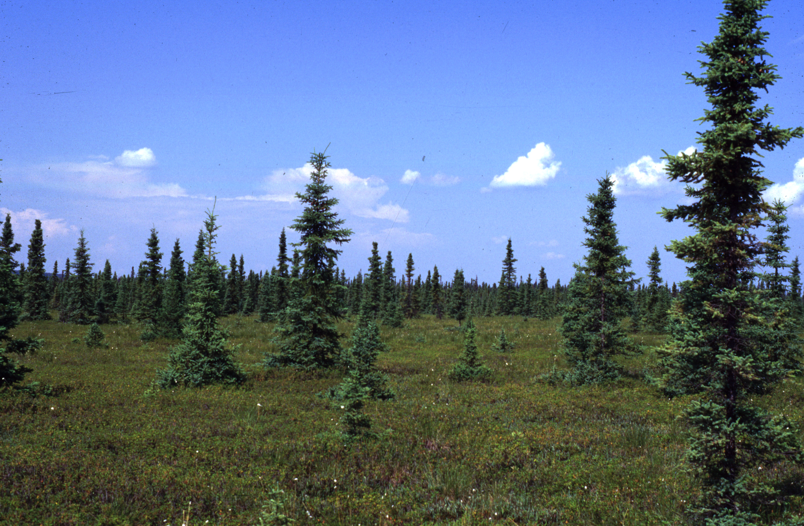
Mosses and Muskeg Matter -
More than you Might Imagine
Kel Wieder; kelman.wieder@villanova.edu
Science Outreach - Athabasca
17 April 2014

Slide 2
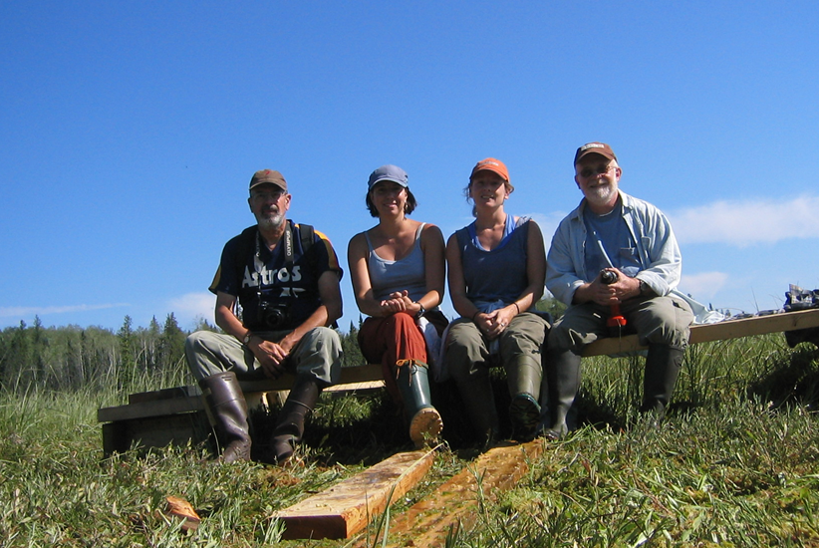




From Google maps

Slide 3
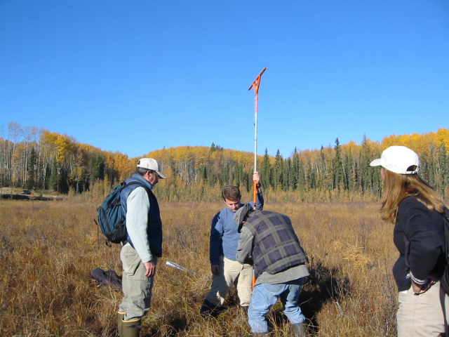
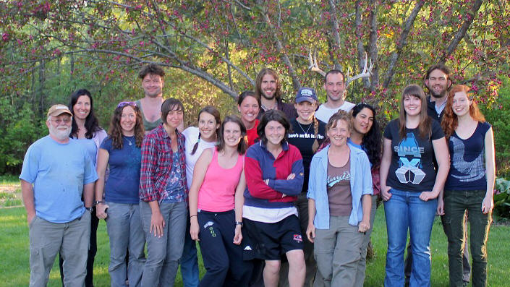
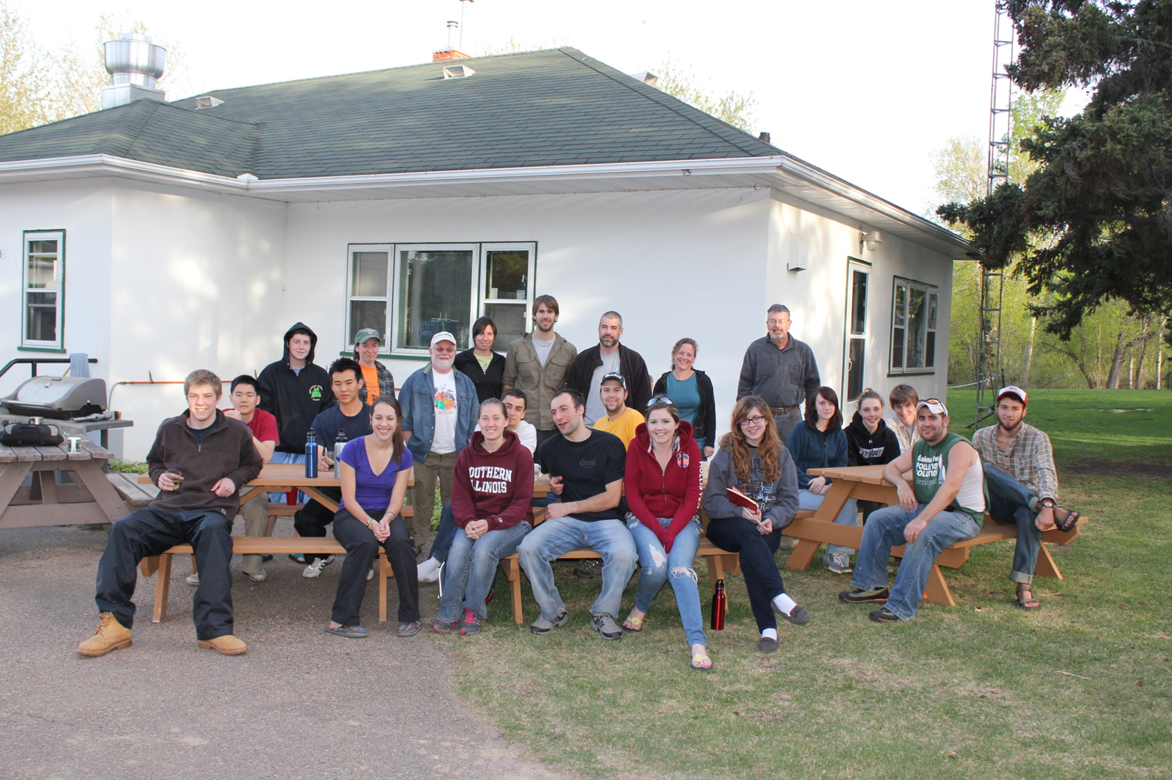
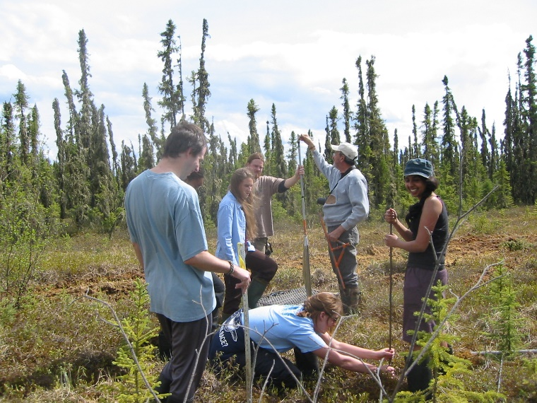
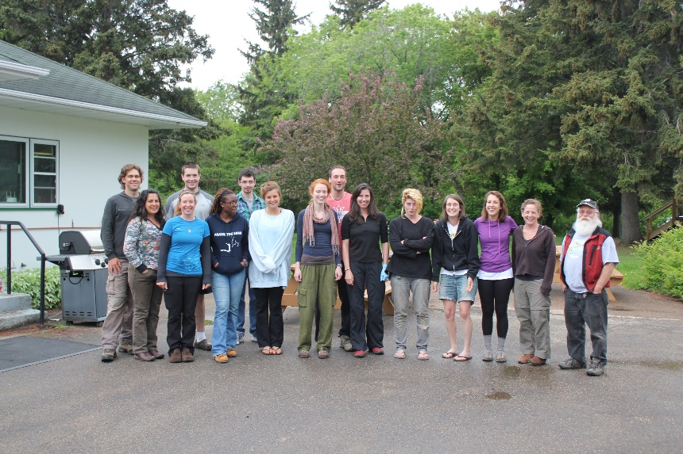
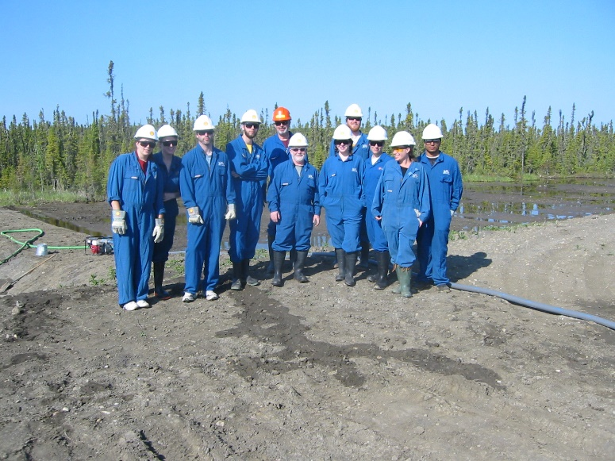
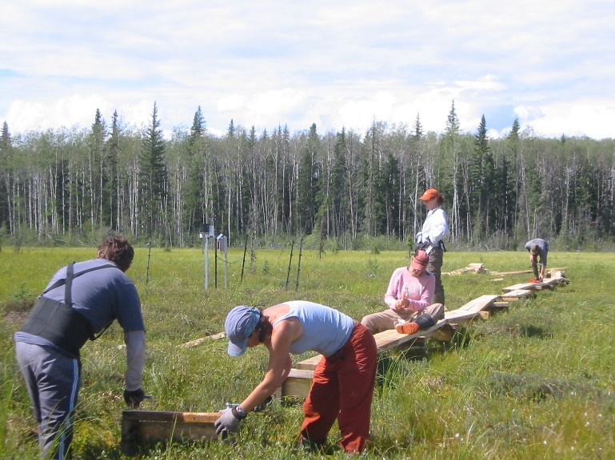
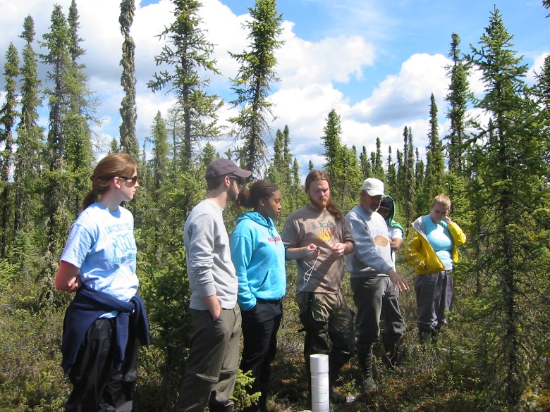
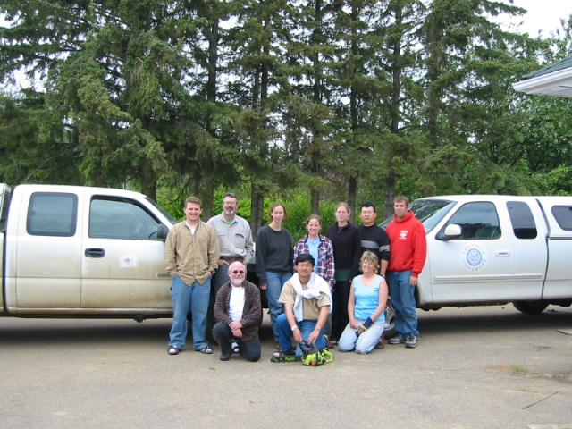

Slide 4
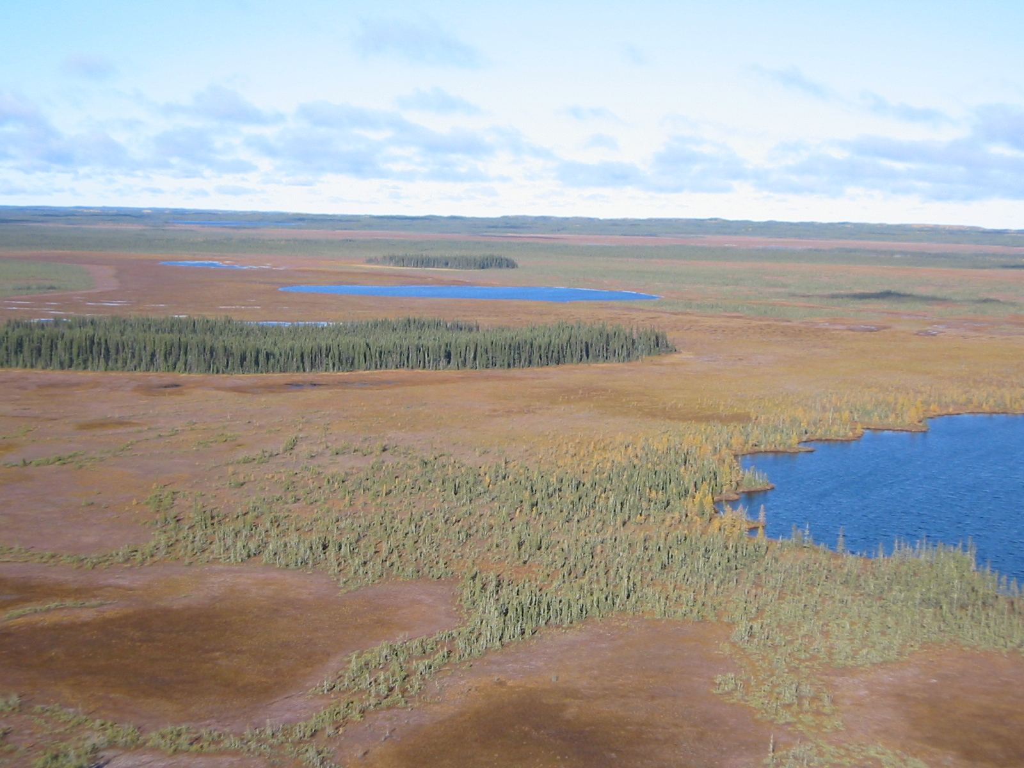
Peatlands 101
Fire and Carbon Cycling
Bogs, Nitrogen, and Oil Sands
Future Directions
Photo by RKW

Slide 5
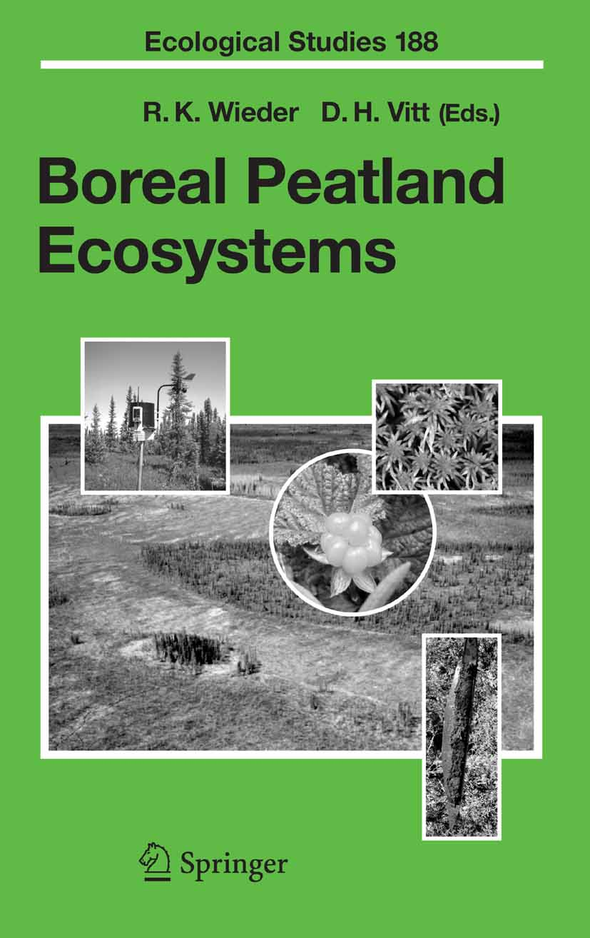
What are Peatlands?
Peatland ecosystems, in the simplest definition, are terrestrial environments where over the long term, on an areal basis, net primary production exceeds organic matter decomposition, leading to the substantial accumulation of a deposit rich in incompletely decomposed organic matter, or peat.
Wieder, Vitt and Benscoter, 2006

Slide 6
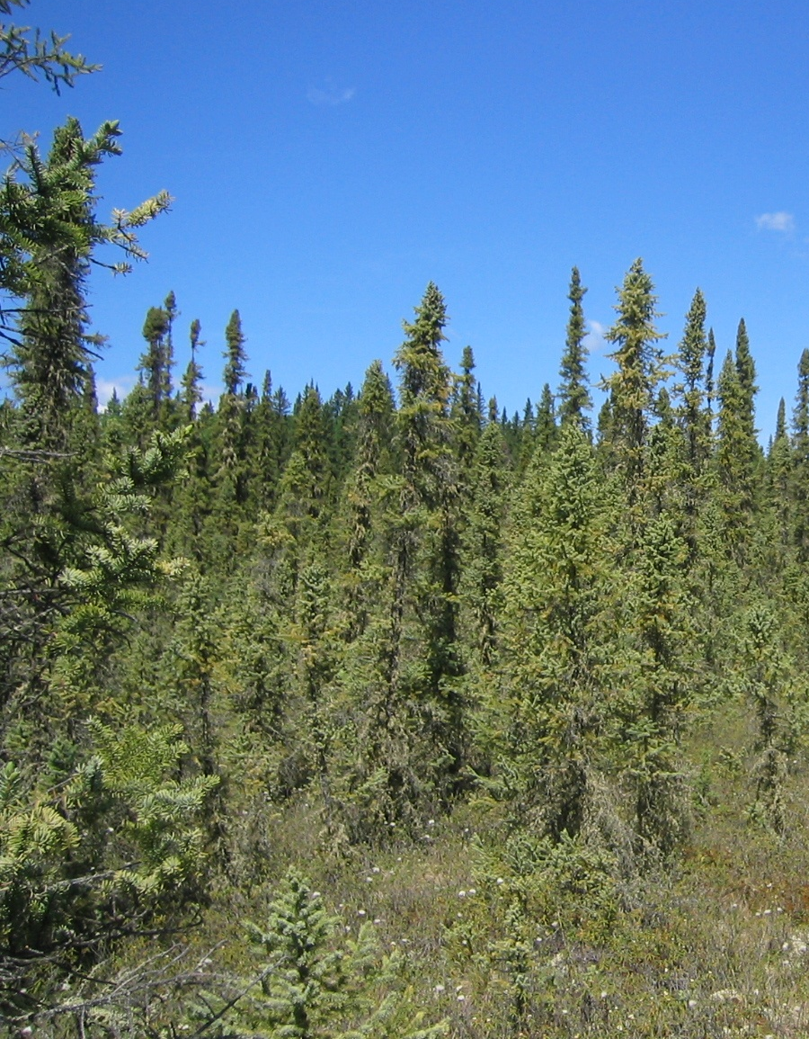
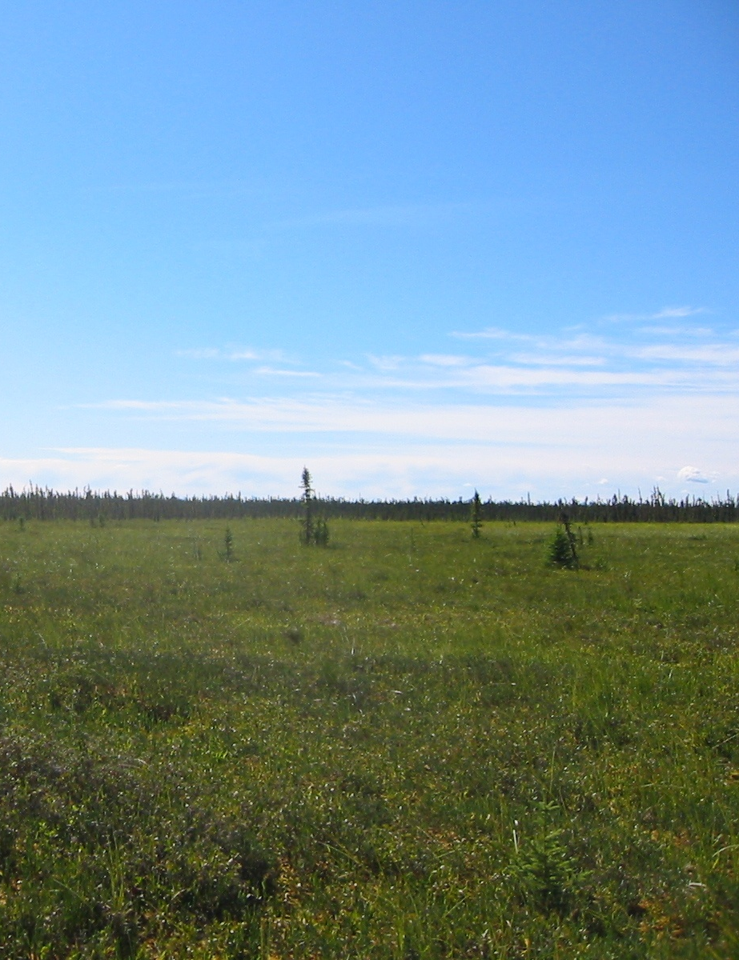
BOG vs. FEN

Slide 7
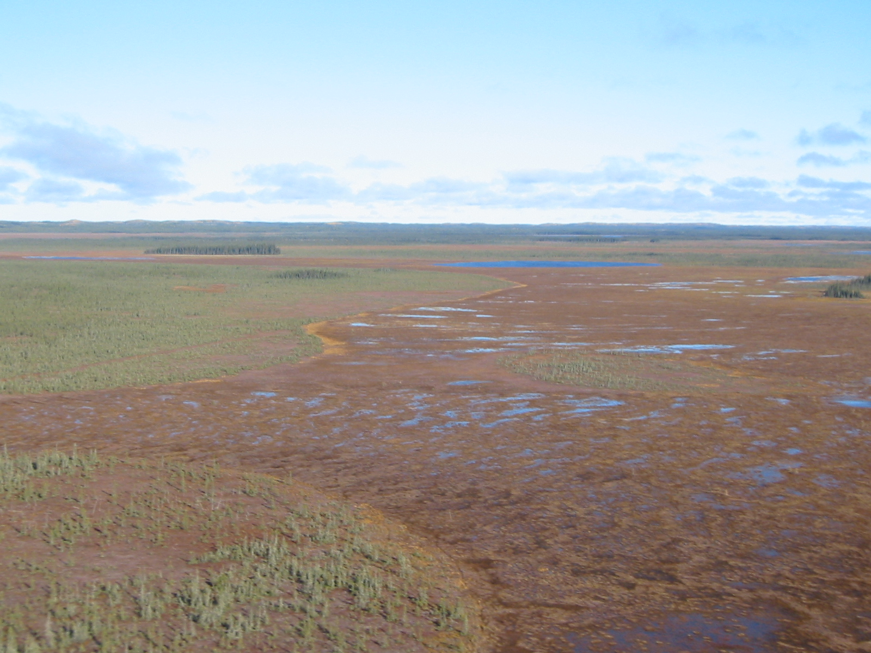

Slide 9
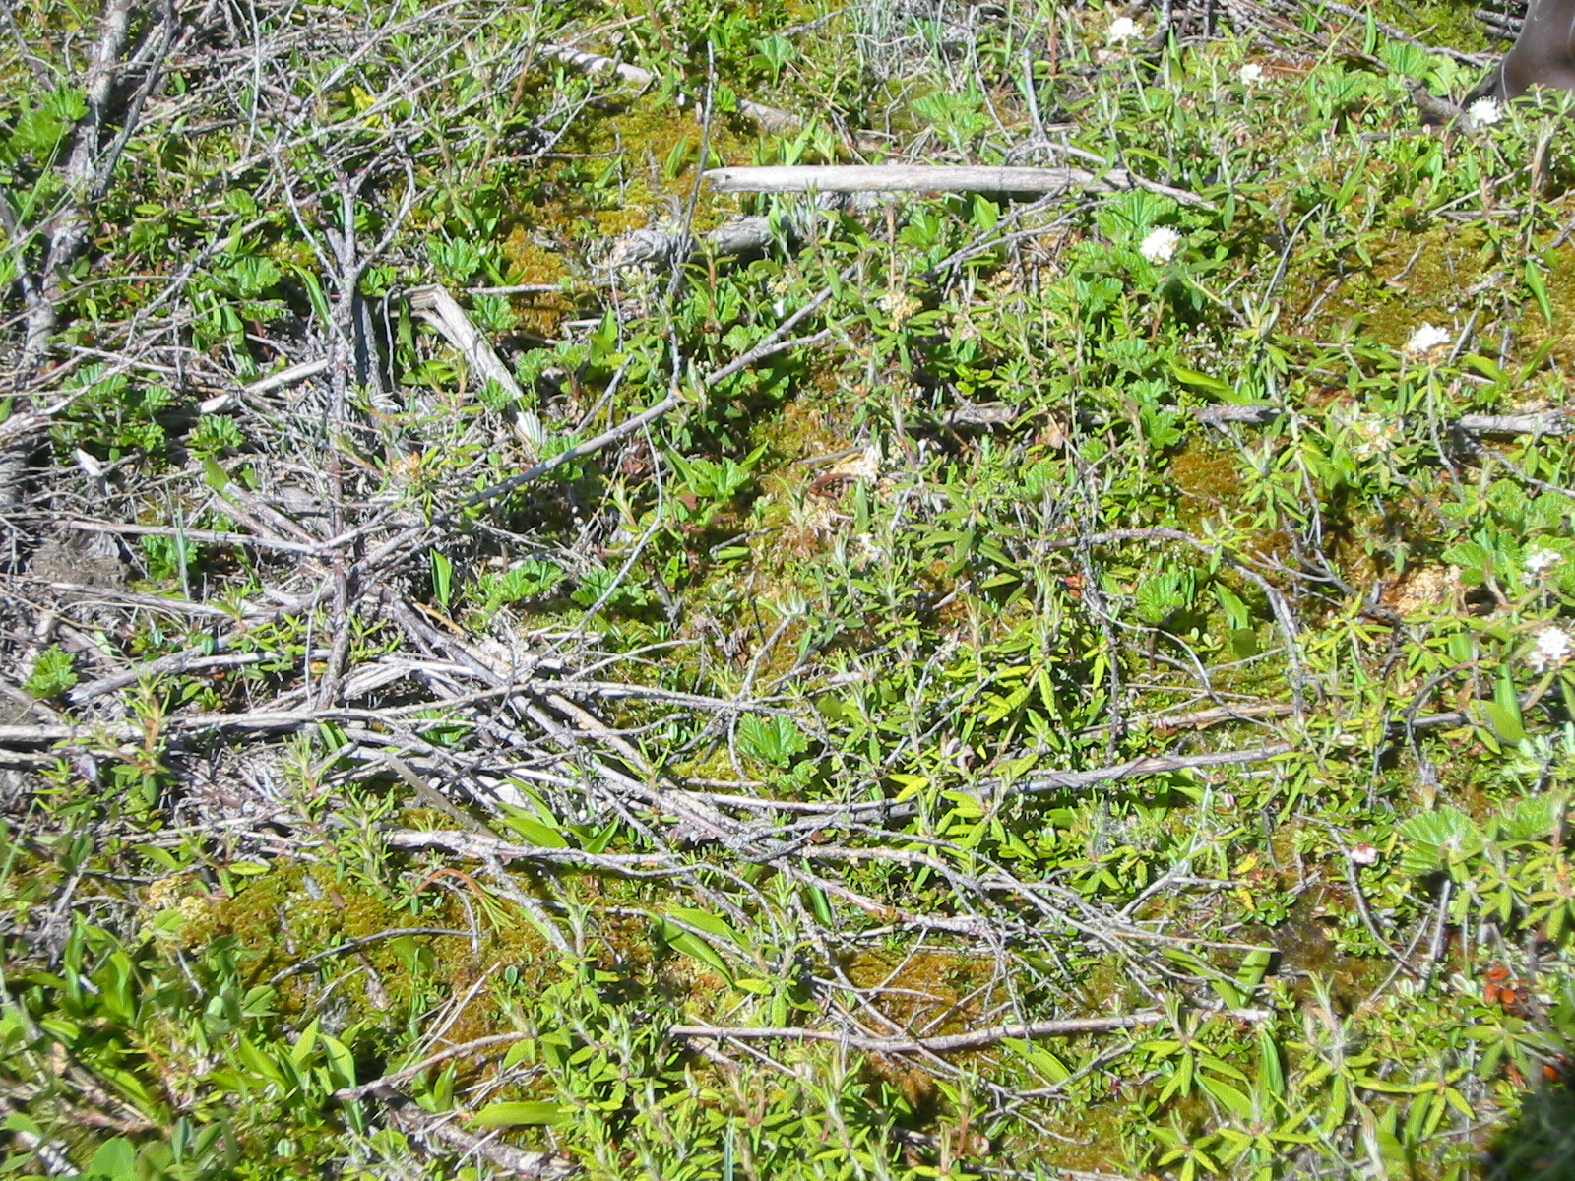

Slide 10
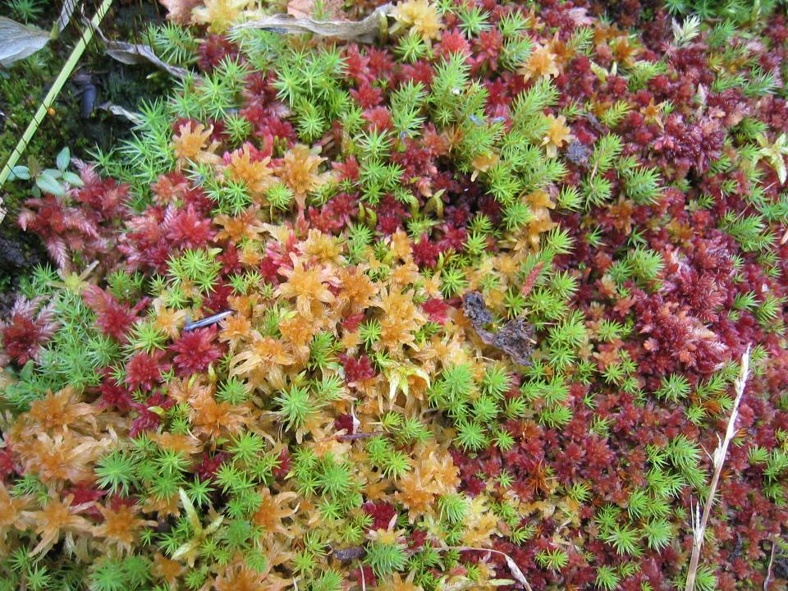

Slide 11
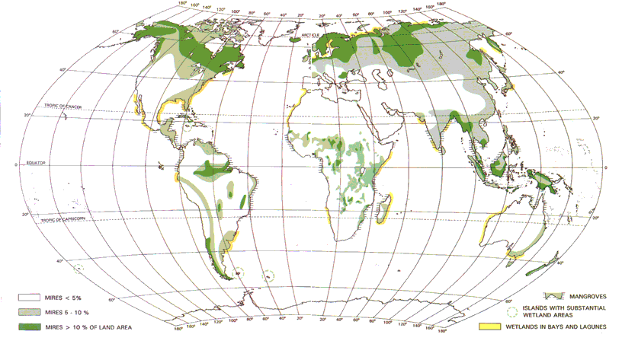
Where are Peatlands?
Global Peatland Distribution
Gore, A.J.P. (1983) Ecosystems of the World 4A: Mires, Swamp, Bog, Fen and Moor: General Studies. Elsevier

Slide 12
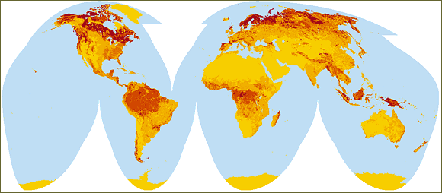

Lots of Carbon in Peatlands
http://earthtrends.wri.org/text/climate-atmosphere/map-227.html

Slide 13
Global Carbon
(values in Pg of C; 1 Pg = 10¹⁵ g)
Atmosphere
720
750+
820
Land plants
560
Non-peatland soils
670
2000
2000
Peatland soils
455
290 - 455
Boreal forest and tundra soils
375
Oceans
38,000
40,000
40,000 deep
800 surface
Coal, oil, gas
10,000
From: Gorham (1991), Schlesinger (1991)
Humans 93
From: http://www.whrc.org/carbon/ - 2004
From: - http://cdiac.esd.ornl.gov/carbon_cycle.html - 2007

Slide 14
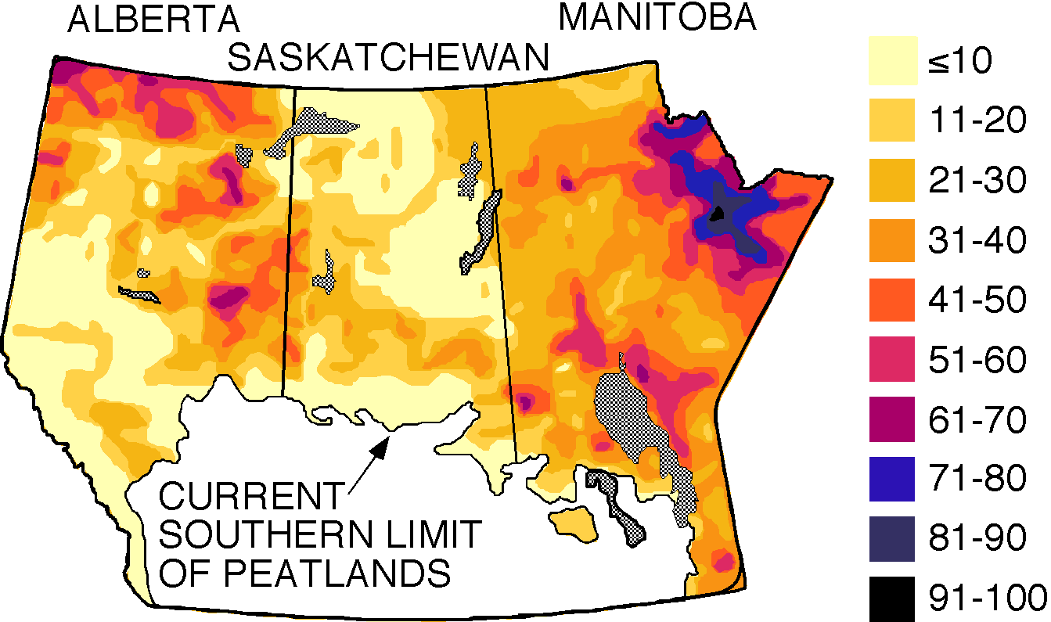
Lots of Peatlands in Alberta
% Cover
Vitt et al. (2000)
Total peatland area = 365,160 km²

Slide 15
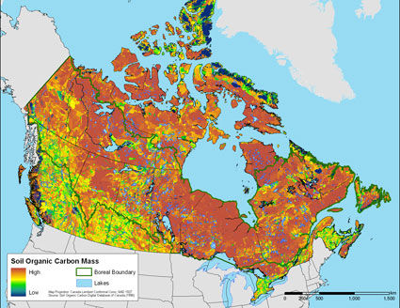
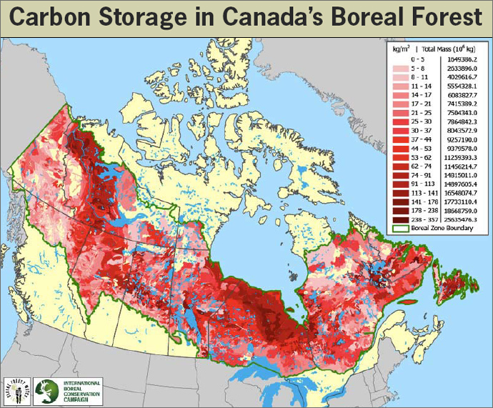
Lots of Carbon in Peatlands of Alberta
http://newswatch.nationalgeographic.com/files/
2009/11/map-of-soil-organic-carbon-mass.jpg
http://www.kleanindustries.com/i/photos/news%20&%20events/redmap3289_12dec07.jpg

Slide 16

The Average Global m² of Peatland Today
Atmospheric CO₂
Atmospheric CH₄
NPP
307 g C m⁻² yr⁻¹
Decomposition
284 g C m⁻² yr⁻¹
Decomposition
0.14 g m⁻² yr⁻¹
P
Pool = 133,000 g m⁻² of C
E
A
Accumulating C at 23 g m⁻² yr⁻¹
Global sink is 76 Tg yr⁻¹
T
Data from Gorham (1990,1991,1995)

Slide 17
DISTURBANCES
Conversion to forestry
Conversion to agriculture
Permafrost degradation
Peat extraction
Dams/Flooding
Fire
Oil sands development

Slide 18
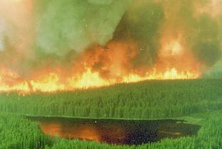
Fire in the Boreal Forest
http://nofc.forestry.ca/fire/frn/

Slide 19
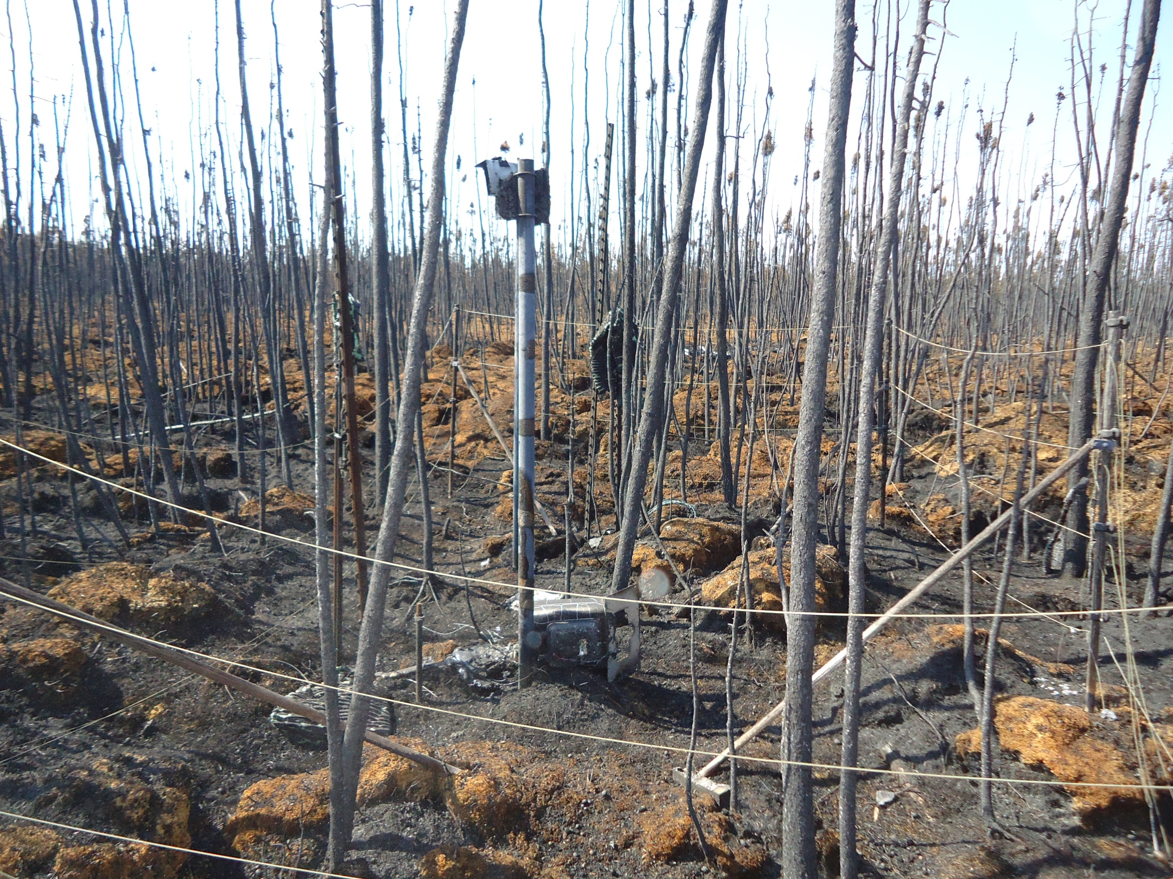

Slide 20
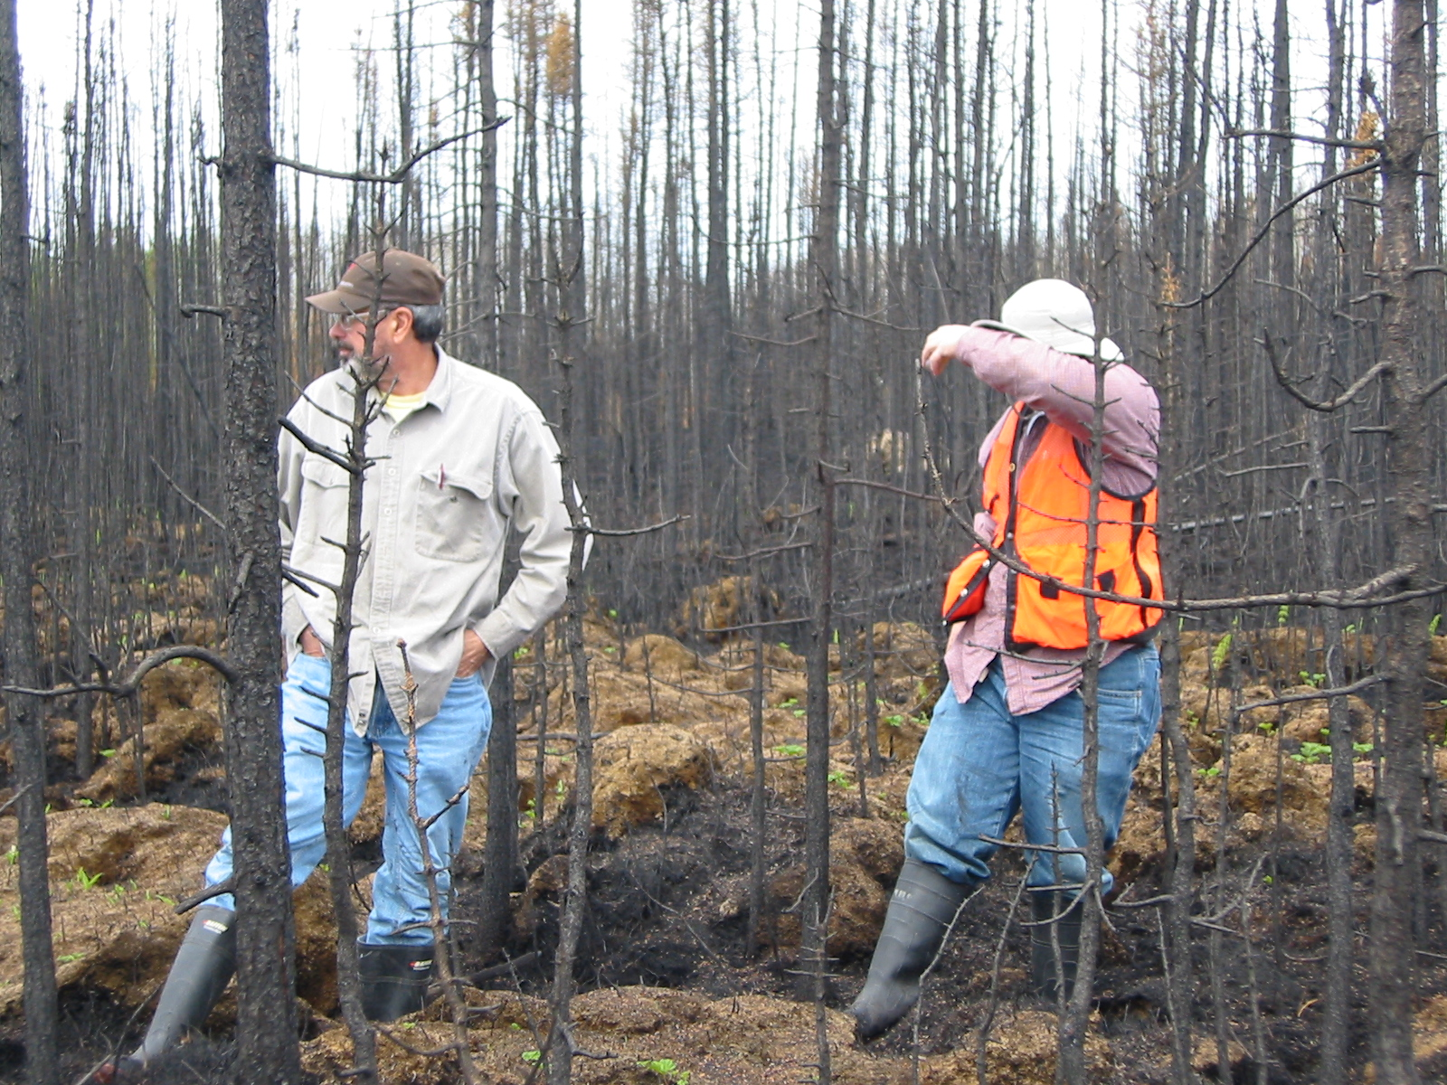

Slide 21
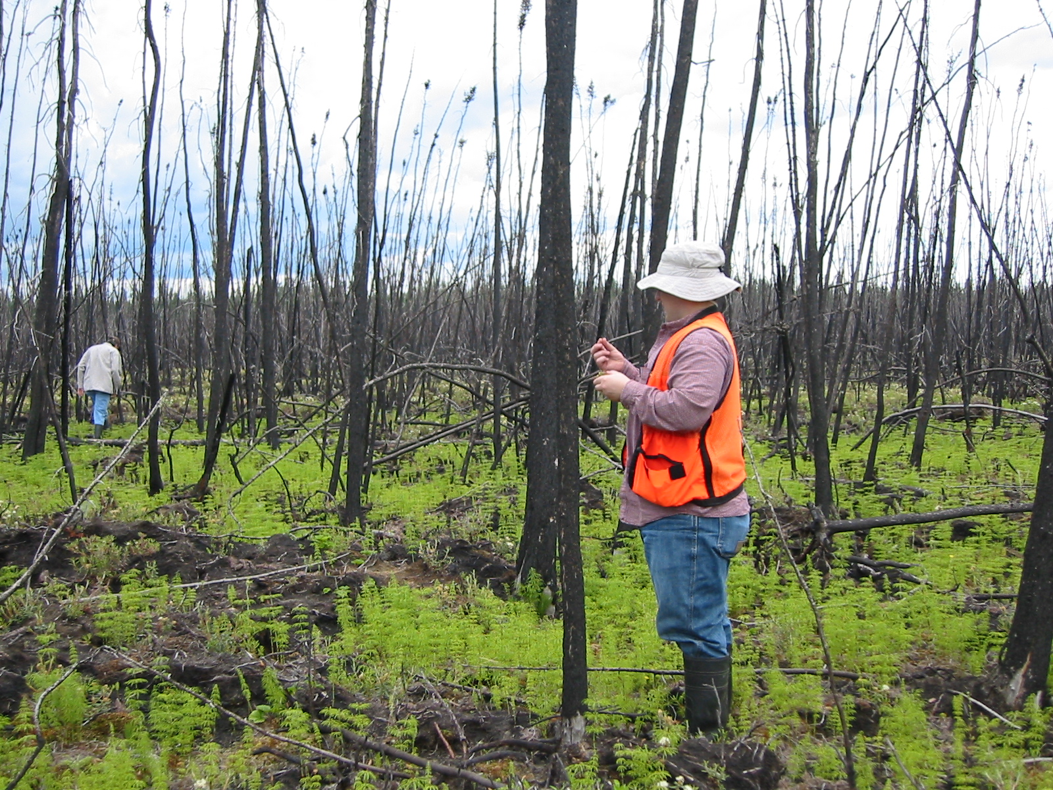

Slide 22
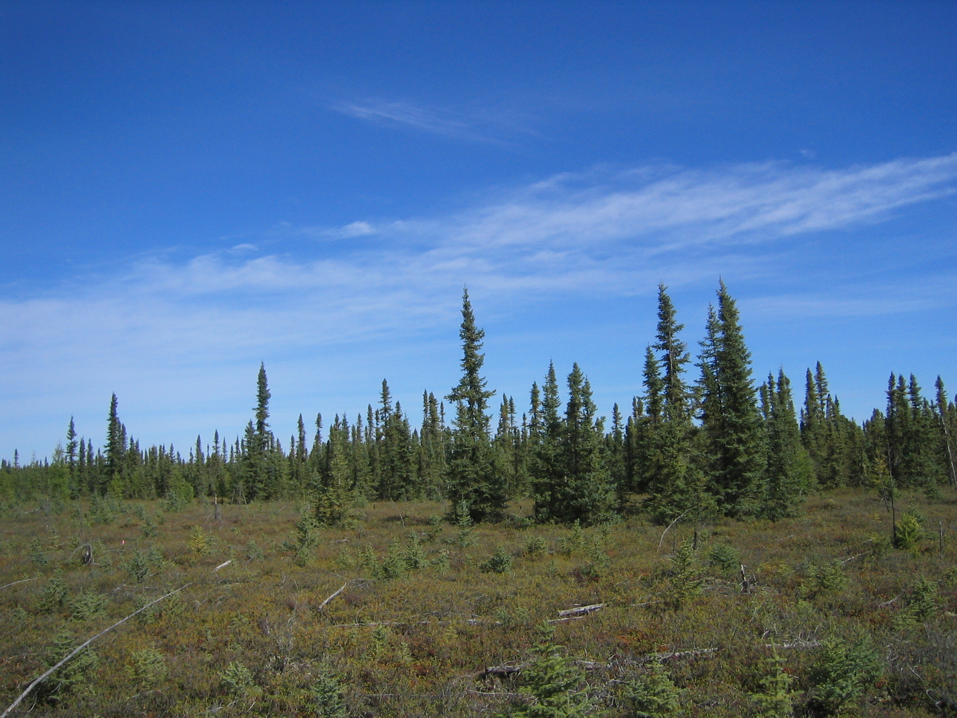

Slide 23
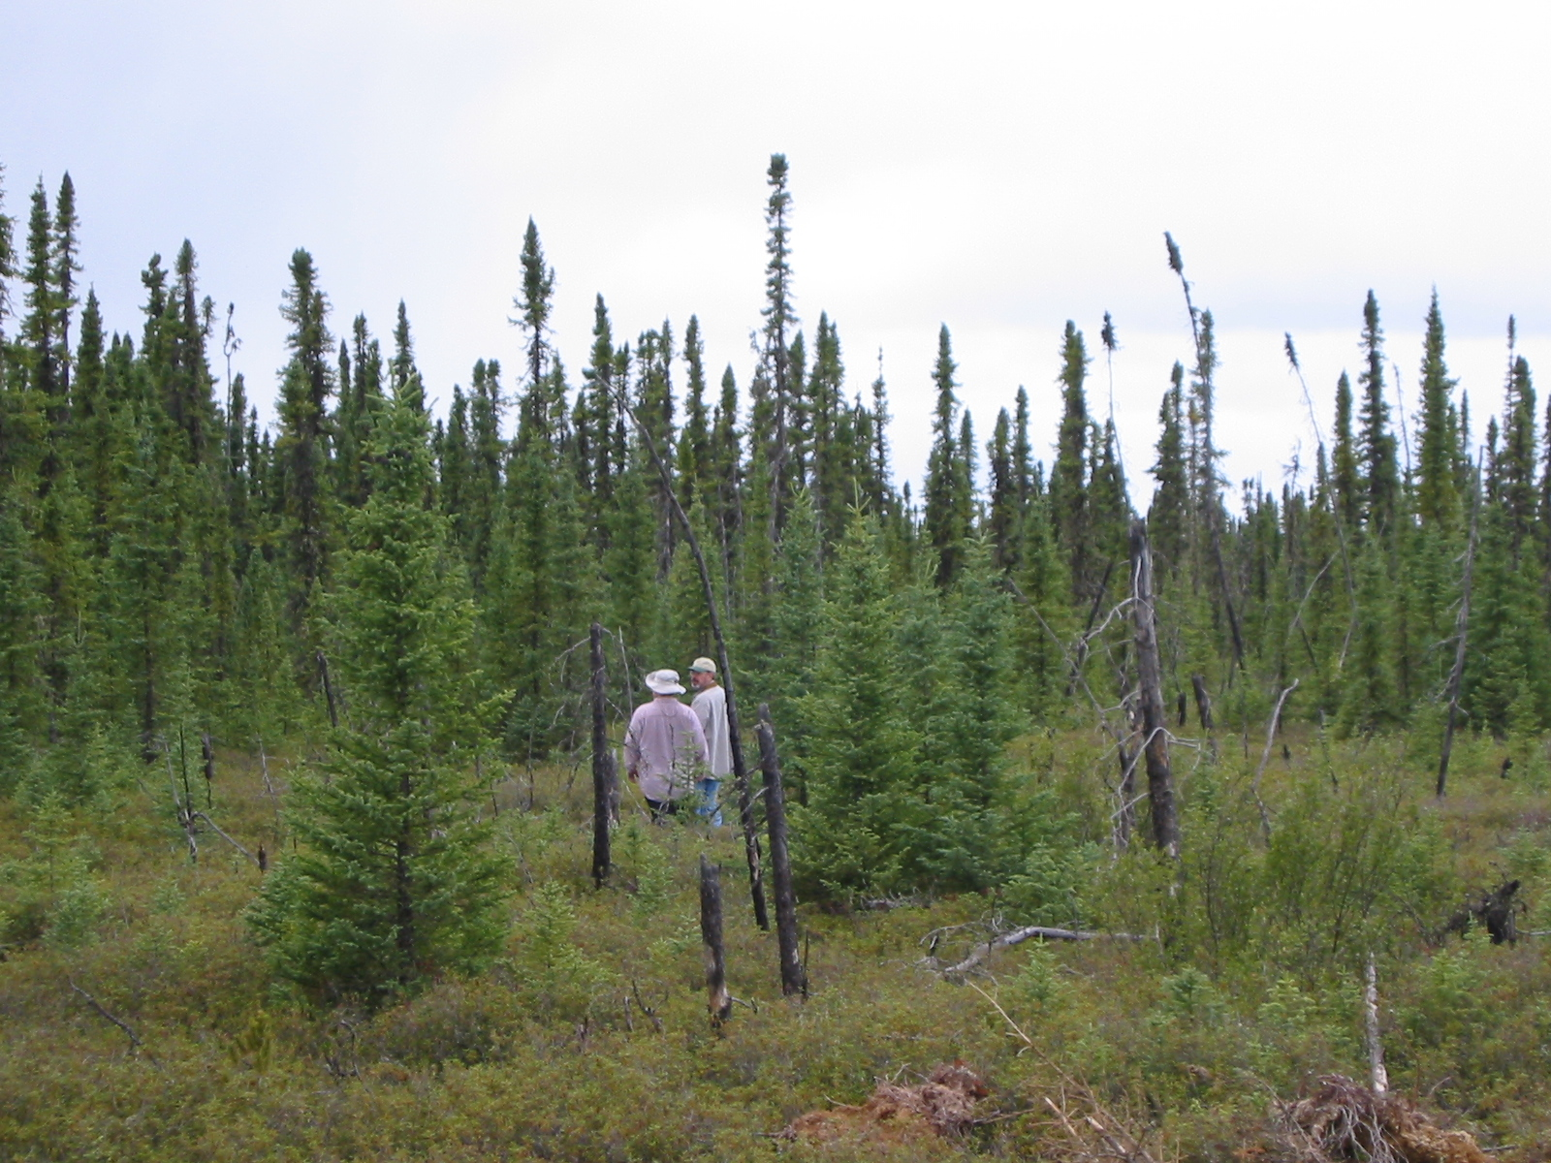

Slide 24
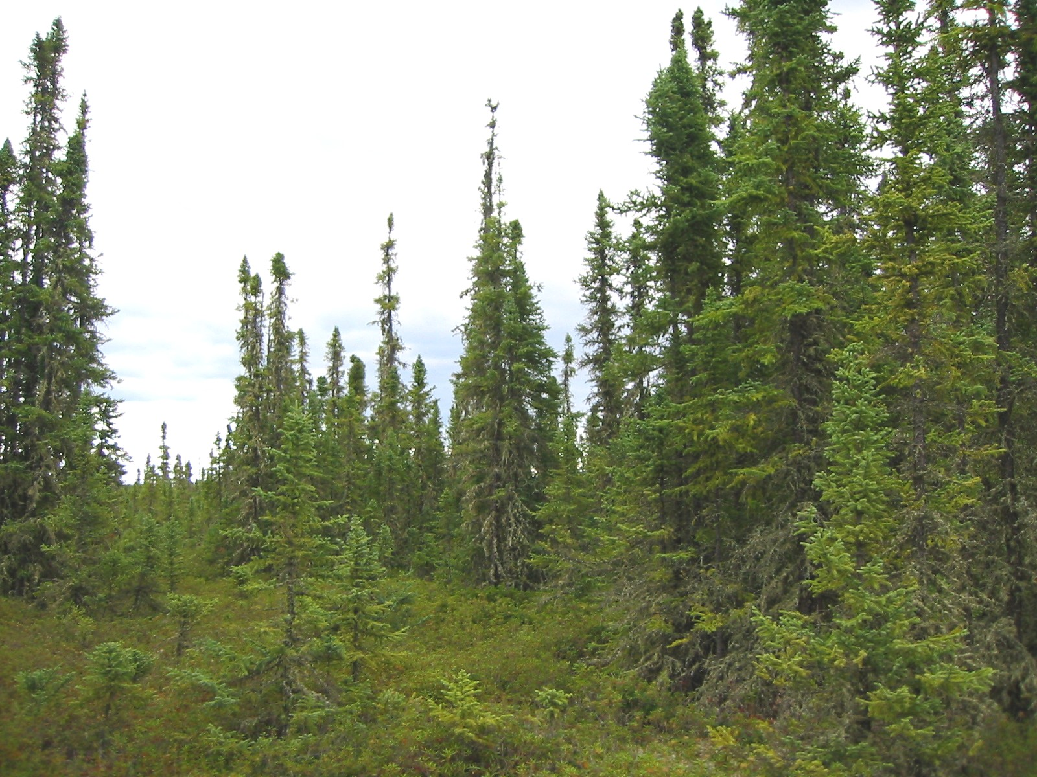

Slide 25
Chronosequence Approach
10 peatland sites, from 1 to 102 years since fire
All bogs in Alberta reasonably accessible by road
Crow Lake
Red Earth Creek
Pelican Lake
Utikuma Lake
Wabasca
Thousands of measurements from 2003-2006

Slide 26
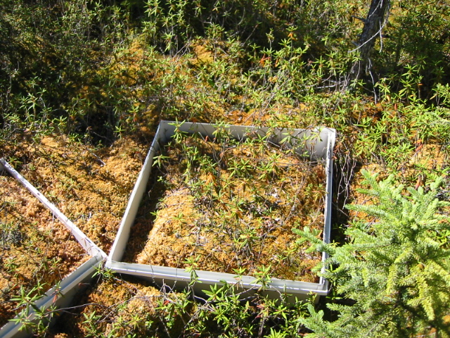

Slide 27
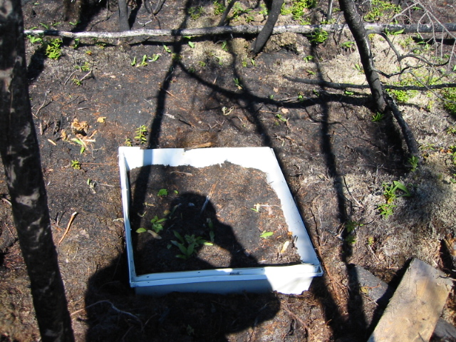

Slide 28
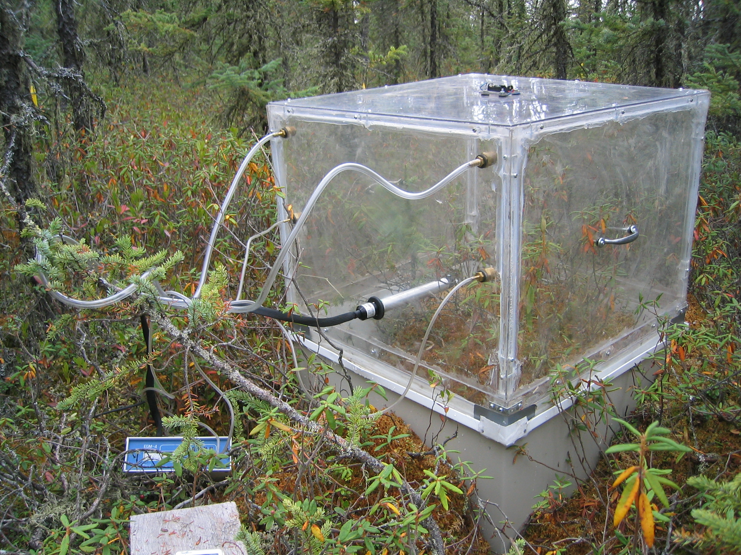
CO₂; photosynthesis > decomposition
bog is a CO₂ sink

Slide 29
CO₂; decomposition > photosynthesis
bog is a CO₂ source

Slide 30
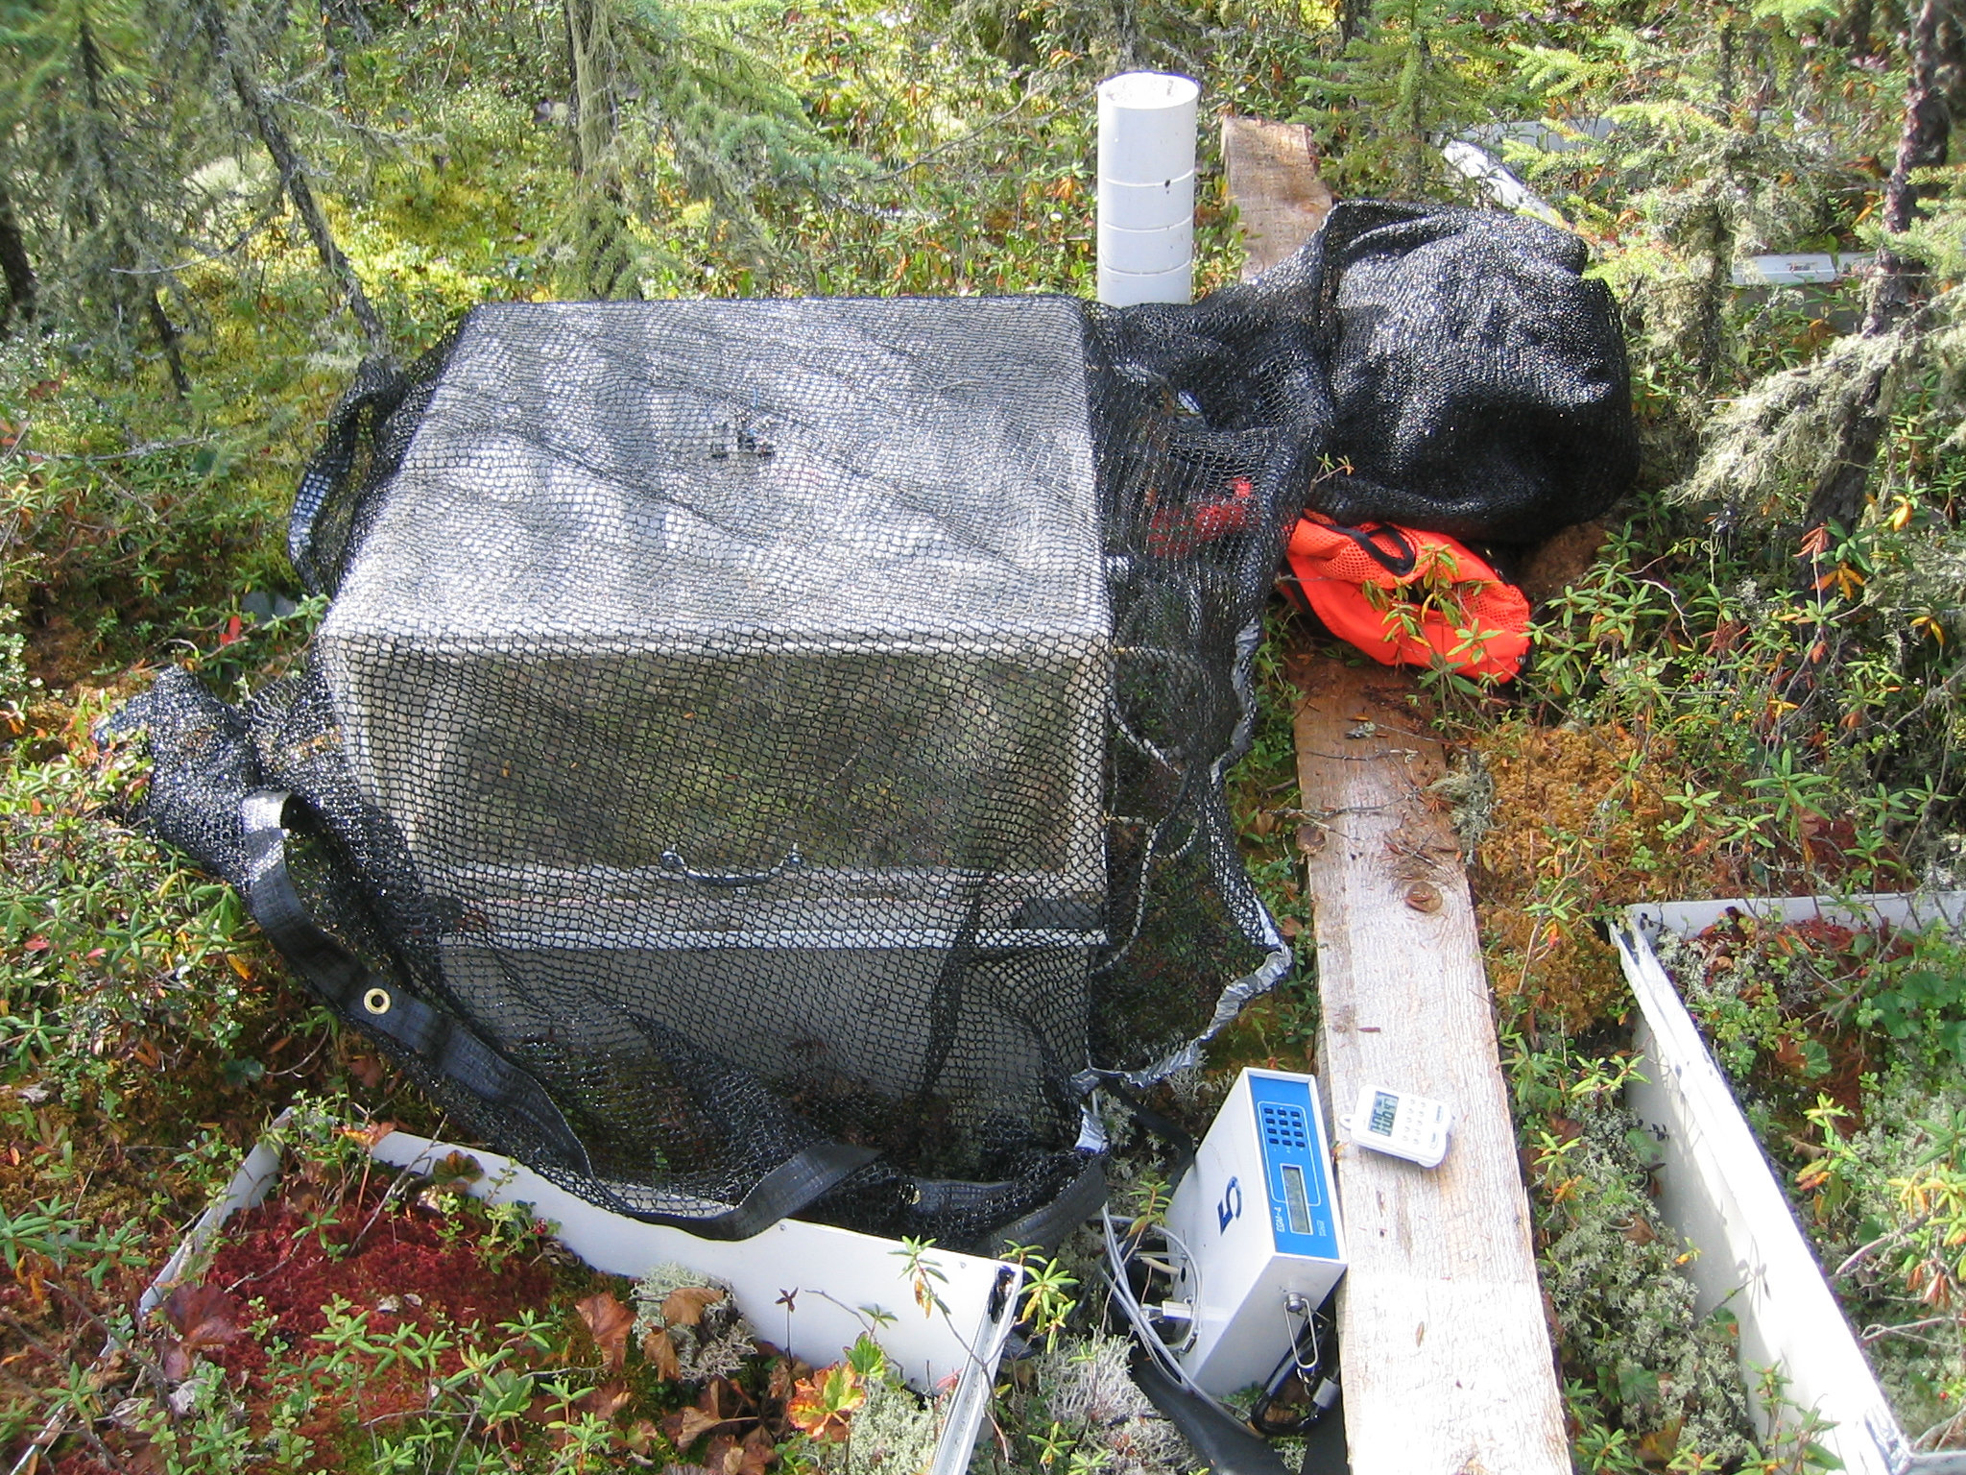

Slide 31
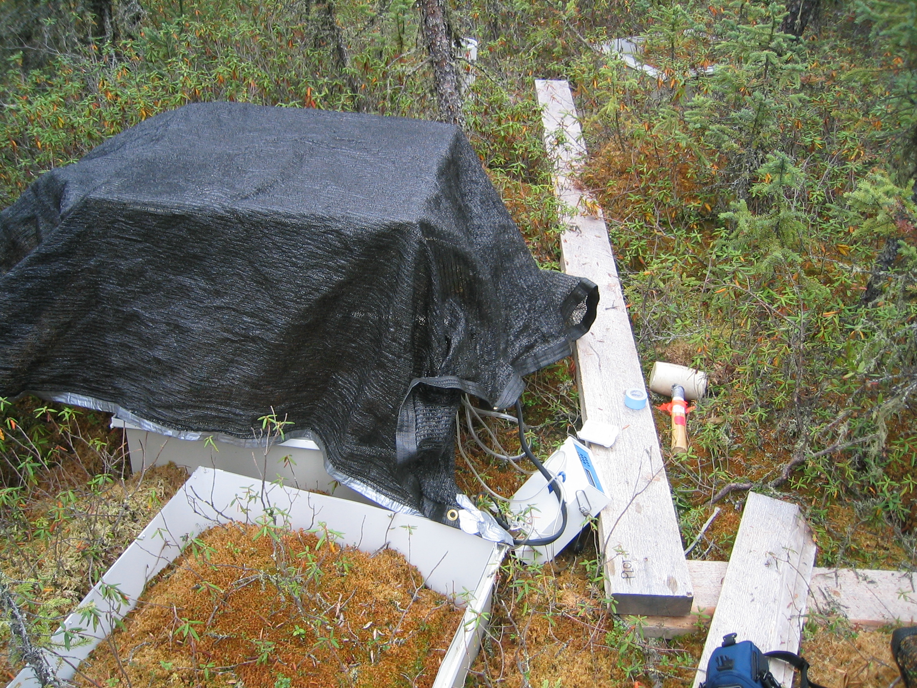

Slide 32
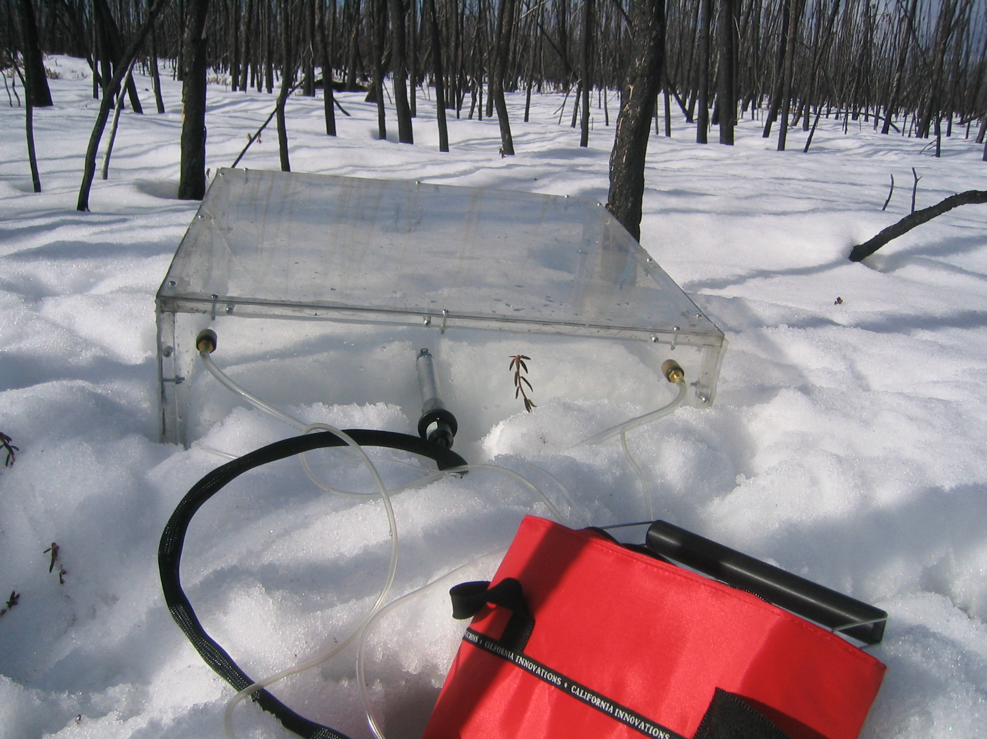

Slide 33
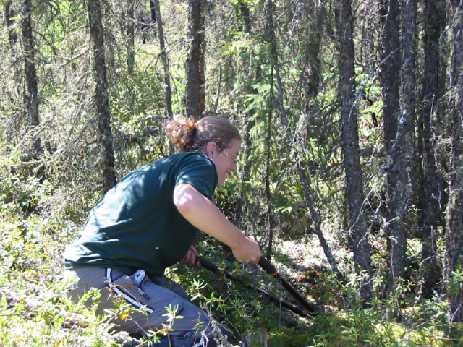
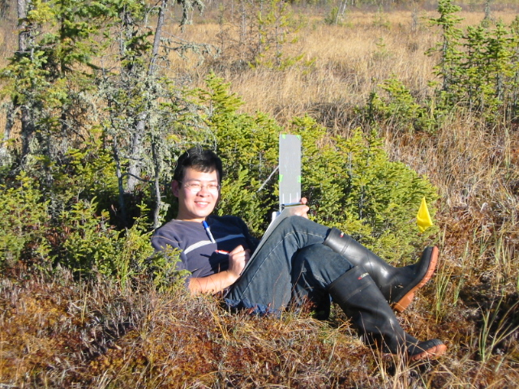
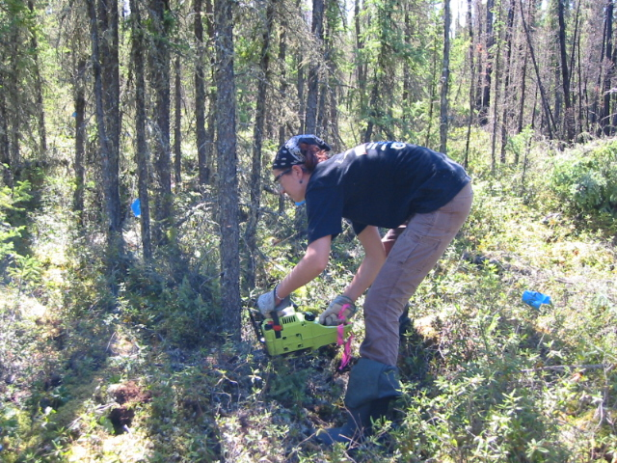
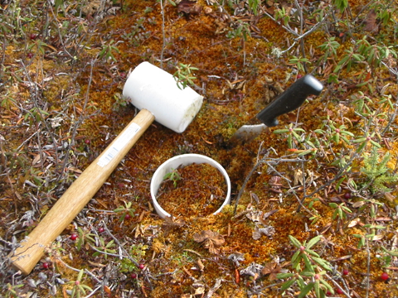
Do black spruce trees play a role?
10-m x 10-m plot at each site
1,632 trees
Measure basal diameter and age
3 10-cm diam., 30 cm deep cores at each site
Sectioned into 3-cm depth increments
Manually pick out roots, dry and weigh

Slide 34
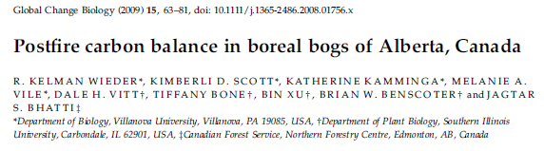
What did we learn?
Bogs are sources of CO₂ to the atmosphere for the first 17 years after fire
After 17 years, bogs are sinks of CO₂, removing CO₂ from the atmosphere storing
it as peat until the bog burns
Black spruce tree growth stores substantial C between 50 and 90 ysf
Overall, Alberta bogs are storing C at a rate of 63 g m⁻² yr⁻¹
A non-winter temperature increase of 2.0 ºC will decrease the regional bog
sink 24 g m⁻² yr⁻¹
If the fire return interval decreases to less than 70 yr, Alberta peatlands will
become a source of C

Slide 35
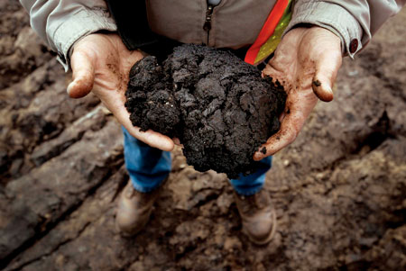
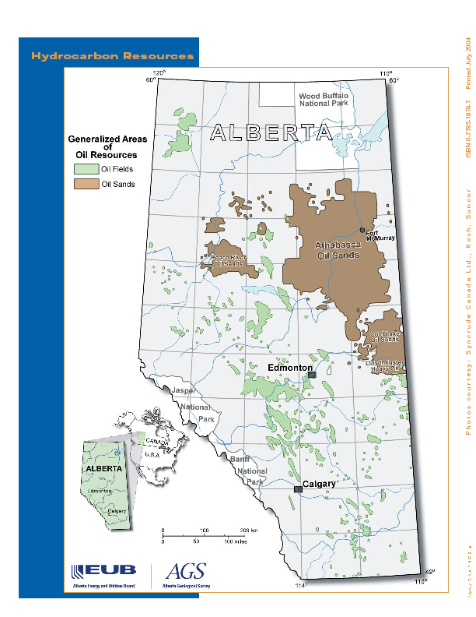
Oil Sands
Source: Alberta Energy Utilities Board

Slide 36
US Oil Imports
2009
2004
Source: US Energy Information Administration
http://www.eia.gov/dnav/pet/pet_move_impcus_a2_nus_epc0_im0_mbblpd_a.htm
Notes:
he 10 CEMA sites were chosen as a subset of the 50 lakes that Preston is monitoring as a part of the RAMP project (I'm not sure what RAMP stands for).

Slide 37
30% of Oil Sands Region is Peatland
% Cover
Vitt et al. (2000)
Total peatland area = 365,160 km²

Slide 38
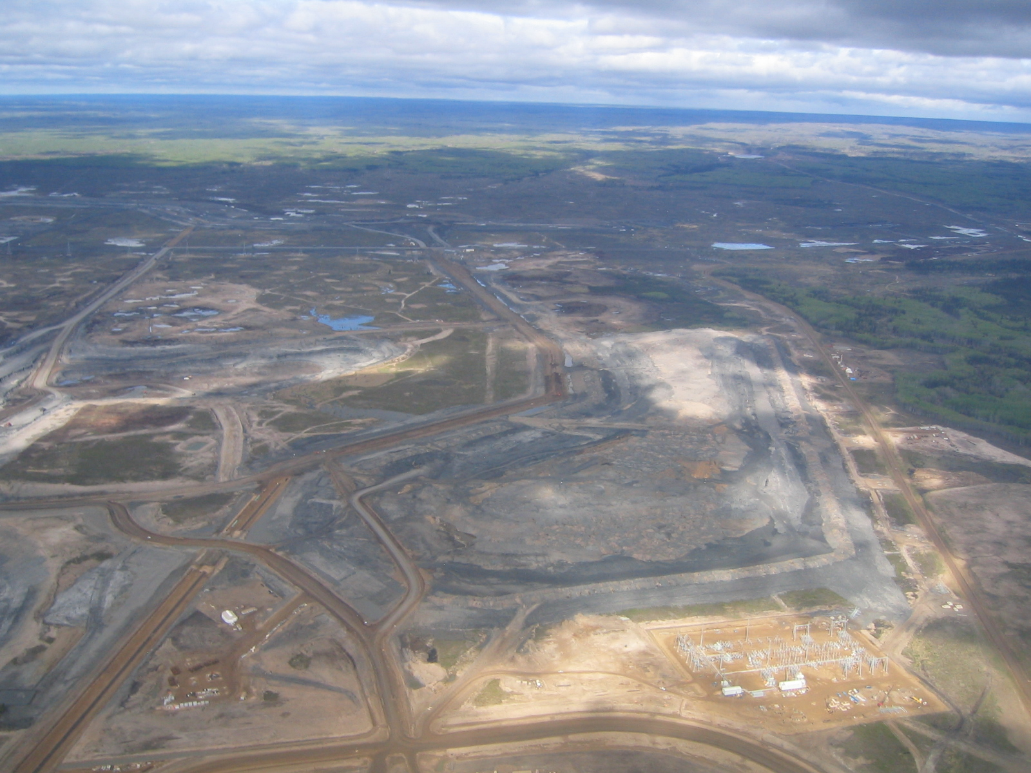
Oil Sands Development
Photo by Kim Scott

Slide 39
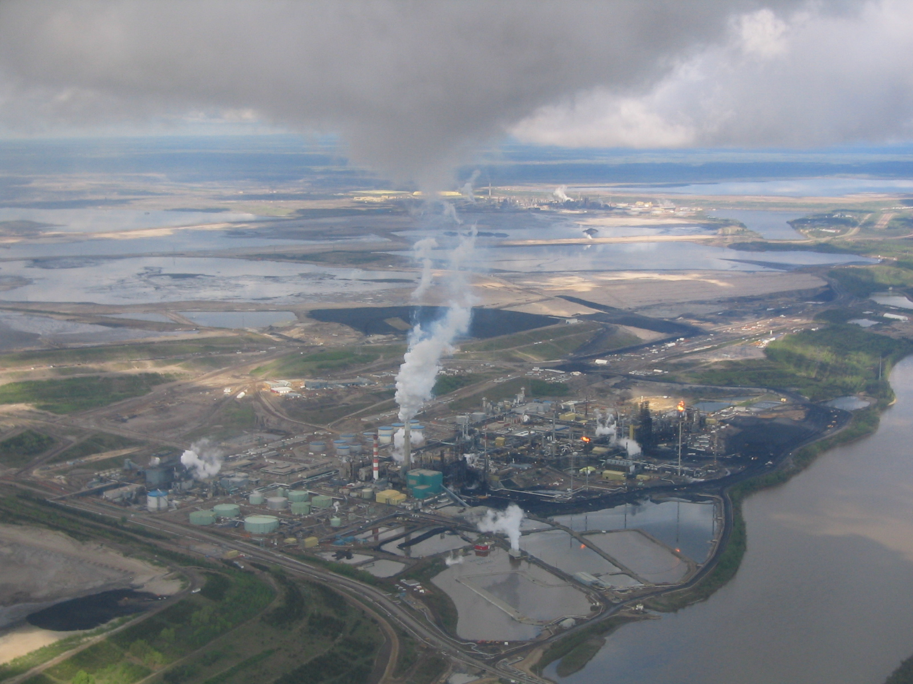
Oil Sands Development
SO_{x}
Photo by Kim Scott

Slide 40
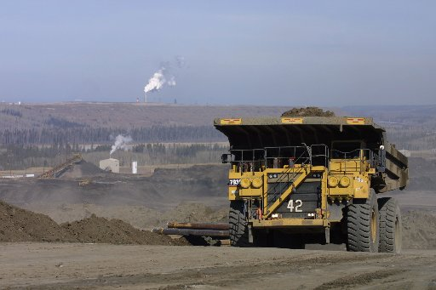
Oil Sands Development
NO_{x}
Photo by Kim Scott
blogs.chron.com

Slide 41
Can bogs serve as monitors of elevated N and S deposition
In the oil sands region?
What are the effects of elevated N and S deposition on
Bogs in the oil sands region?

Slide 42
Why Bogs?
Bogs are nutrient poor, acidic systems
Likely to respond to elevated N inputs
European research in the 1970s and 1980s has shown sensitivity of bogs to
elevated N and S deposition, including widespread loss of Sphagnum mosses
across the Pennines of the UK
This loss continues today:
McClymont et al. 2008. The disappearance of Sphagnum imbricatum from Butterburn Flow, UK.
The Holocene 18: 991-1002.
Hughes, P.D.M. et al. 2008. The declining quality of late-Holocene ombrotrophic communities and the
loss of Sphagnum austinii (Sull. ex Aust.) on raised bogs in Wales. The Holocene 18: 1033-1043.
Increasing N deposition is expected to:
initially increase Sphagnum growth
subsequently, increase plant tissue N concentrations
subsequently, permit N leaching through the upper peat layers
thereby increasing shrub production
and shading out Sphagnum mosses and berry-producing shrubs

Slide 43
Why Bogs?
The Oil Sands Administration Area – 14,042,214 ha
4,123,554 ha of peatlands, or 29% of the OSAA
461,838 ha potentially changed/converted under full development
(Lee & Cheng 2009)
(does not include peatlands affected by elevated N and S deposition)
Corresponds to reduction of the regional net sink for atmospheric CO₂
from 3.2 + 1.2 Tg C/yr to 2.8 + 1.1 Tg C/yr (Wieder et al., 2013)

Slide 44
WHY BOGS?
Why Bogs?
The Oil Sands Administration Area – 14,042,214 ha
4,123,554 ha of peatlands, or 29% of the OSAA
461,838 ha potentially changed/converted under full development
(Lee & Cheng 2009)
(does not include peatlands affected by elevated N and S deposition)
Corresponds to reduction of the regional net sink for atmospheric CO₂
from 3.2 + 1.2 Tg C/yr to 2.8 + 1.1 Tg C/yr (Wieder et al., in press)
Peatlands represent a huge water reservoir
Below the water table – peat is about 95% water by volume
Assuming average peat depth of 3 m, peatlands in the OSAA hold
118 million m³ of water
Assuming average peat depth of 3 m, peatlands across Alberta hold about
300 million m³ of water
Lac La Biche contains 2 million m³ of water
Lesser Slave Lake contains 13 million m³ of water
Peatland water often feeds lakes and streams – hydrologic connectivity

Slide 45
Photo by RKW

Slide 46
Study Sites

Slide 47
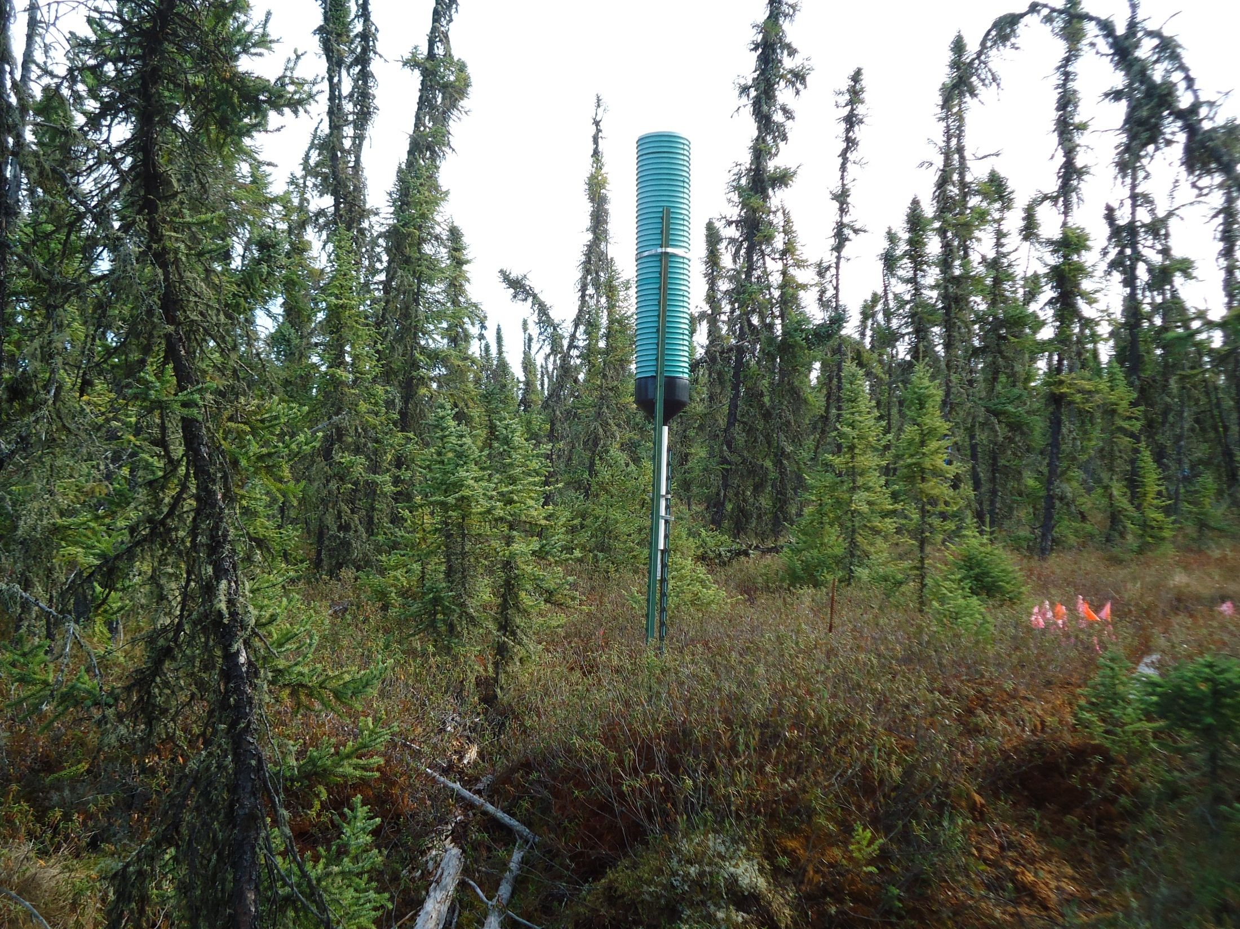

Slide 48
Elevated N and S Deposition

Slide 49
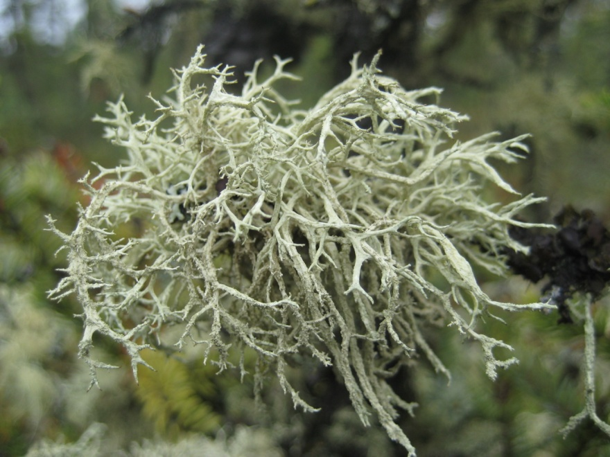
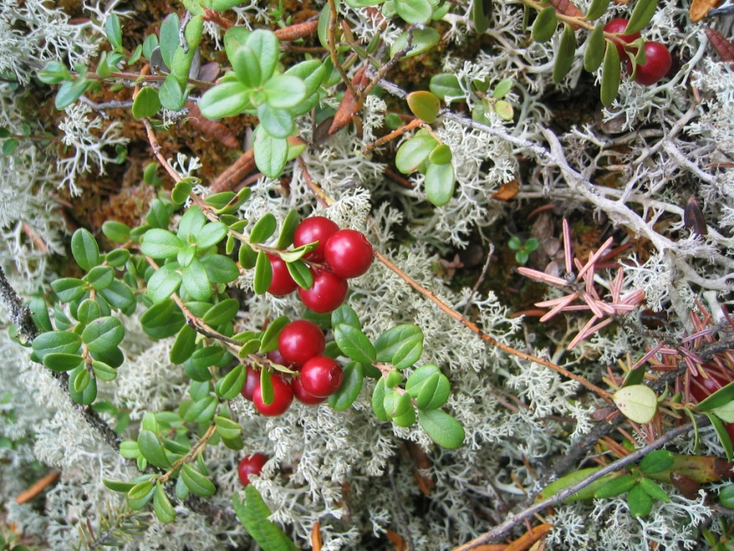
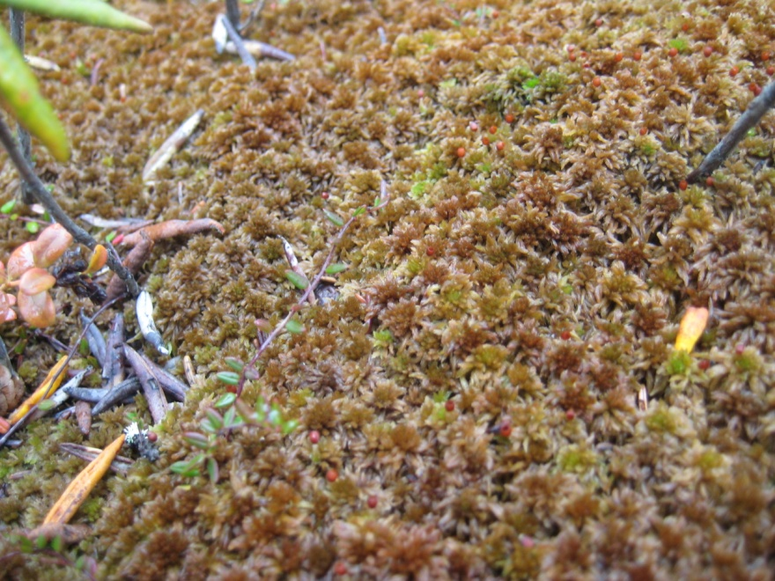









Do Plants Respond?
Evernia mesomorpha
Vaccinium vitis-idaea
Sphagnum fuscum
Sphagnum angustifolium
Cladina mitis
Oxycoccos microcarpus
Sphagnum capillifolium
Rubus chamaemorus
Picea mariana
Ledum groenlandicum
Sphagnum magellanicum
Smilacina trifolia

Slide 50
Plants do Respond
For many of the bog plant species, concentrations of
nitrogen (and sulfur) increase with closer proximity
to the oil sands mining area
For many of the bog plant species, concentrations of
nitrogen (and sulfur) have been steading increasing
over time (2009-2013)
Final report submitted to WBEA earlier this spring

Slide 51

Broader Regional Bog Survey

Slide 52





Slide 53
What have we learned?
Bog waters affected (more acidic, more nitrogen,
more sulfate) within 20-40 km distance of oil sands
mining area
Some bog mosses, lichens, vascular plants show elevated
nitrogen (and sulfur) concentrations within 20-40 km
distance of oil sands mining area
Samples still being processed…
Implications – elevated N inputs are likely to lead to
increased shrub growth, shading out mosses and
berry-producing plants

Slide 54

How much nitrogen can bogs, fens,
and jack pine forests take?

Slide 55


Slide 56


Slide 57


Slide 58


Slide 59


Slide 60


Slide 61


Slide 62


Slide 63


Slide 64


Slide 65


Slide 66

Shrubs Respond!

Slide 67

Future Directions

Slide 68


Future work…
The word “bog” occurs 0 times
The word “fen” occurs 0 times
The word “peatland” occurs 0 times
The word “wetland” occurs twice,
both as “…wetland-associated birds…”
Darnit! Nobody told me there was peat up here - $#@!&
http://upload.wikimedia.org/wikipedia/commons/a/a3/Muskeg_D6_caterpillar.jpg

Slide 69


Peat researchers at MBRS
Florida Atlantic University
McMaster University
Southern Illinois University
University of Guelph
Villanova University
Since 2000
3 PhDs
20 Masters
22 papers in leading scientific journals
Over 100 presentations at scientific
conferences
MBRS served as a gateway for
researchers from Alberta, Canada, and
beyond to study Alberta’s boreal regions
Hopefully MBRS will continue to serve
well into the future

Slide 70

Why peat?
Consider how remote and novel that swamp. Beneath it is a quaking bed of Sphagnum, and in it grow … plants which scarcely a denizen of Concord ever sees. … There are square rods in Middlesex County as purely primitive as they were a thousand years ago, which have escaped the plow, the axe, and the scythe and the cranberry rake, little oases of wilderness in the desert of our civilization.
The Journal of Henry David Thoreau, Volume IX,
August 30, 1856;
P.M. To Vaccinium Oxycoccus Swamp
www.luciekom.worldpress.com

Slide 71

Thanks to
Meanook Biological Research Station –Warren Zyla, Brandon Nichols, others
Athabasca University, Athabasca River Basin Research Institute
Science Outreach - Athabasca
Koch Ford
Fas Gas
Kal-Tire
Gregg Distributors
Tru Hardware
Home Hardware
Canadian Tire
UFA
Extra Foods
Buy-Low
Burger Bar
Cheap Seats
Dollar Store
The Whiskey Store
Anderson’s Liquor
Landing Liquor Store
Athabasca Healthcare Centre
Rexall Drug Store
Whispering Hills Fabric & Craft Supplies
Athabasca Thrift Shop
SS Athabasca Car Wash
Athabasca Car & Truck Wash

